Slide 1
Control Statements
Module 3

Slide 2
Module Objectives
Describe the different control statements in Python
Control program execution flow using control statements such as if and while
Use looping structures in your Python programs
Implement branching within looping structures such as for and range
Implement breaking out of loops

Slide 3
Lesson 3.1.1: Program Flow
Describes the way in which statements are executed.
Python has top-down program flow.

Slide 4
Lesson 3.1.2: Control Statement
Control statement is structure that conditionally changes program flow.
Two main controls statements in Python:
if
while

Slide 5
Lesson 3.2: The if Statement (1 of 2)
Allows execution of block of code if condition is true, otherwise it can run alternate block in else clause.
else clause is optional.
Can chain multiple if statements together.
Syntax is shown in Snippet 3.1.

Slide 6
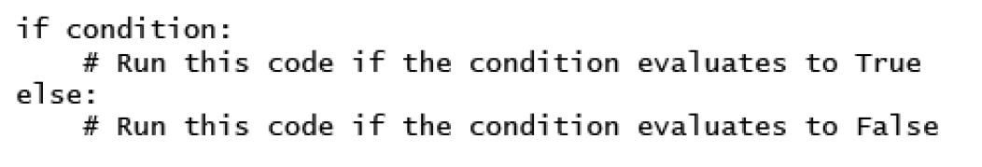
Lesson 3.2: The if Statement (2 of 2)
Snippet 3.1

Slide 7
Lesson 3.3: The while Statement (1 of 2)
Allows execution of block of code repeatedly, as long as condition is true.
else clause is optional.
Can also have else clause.
This will be executed exactly once when condition is no longer true.
Syntax is shown in Snippet 3.13.

Slide 8
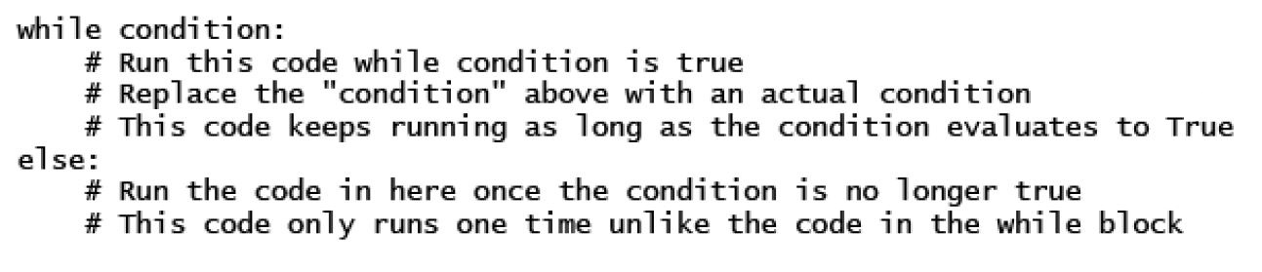
Lesson 3.3: The while Statement (2 of 2)
Snippet 3.13

Slide 9
Lesson 3.4: while Versus if
if gives opportunity to branch execution of code based on condition.
while gives opportunity to run block of code multiple times as long as condition is true.
Can be considered a loop.

Slide 10
Lesson 3.5: Loops
Way to execute specific block of code multiple times.
Used to iterate (or loop) over iterables.
Iterables
Are anything that can be looped over.
Are anything that can appear on the right side of a for loop.
Think of as a collection of things that have been grouped together.

Slide 11
Lesson 3.6: The for Loop (1 of 2)
Also referred to as the for…in loop.
Used when you want to repeatedly execute a block of code a given number of times.
Runs a predetermined number of times.
while loop runs an arbitrary number of times.
Syntax shown in Snippet 3.33.

Slide 12
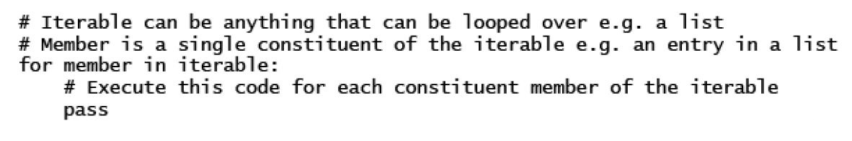
Lesson 3.6: The for Loop (2 of 2)
Snippet 3.33

Slide 13
Lesson 3.6.1: Using else
else statement optional for for loop.
Will execute once when loop exits cleanly.
Useful for debugging.

Slide 14
Lesson 3.7: The range Function
Built-in function that generates list of numbers.
Used to perform action predetermined number of times.
Syntax: range([start], stop, [step])
start: Optional. Starting number in sequence.
stop: Generate number up to but not including this number.
step: Optional. Difference between each number in sequence.

Slide 15
Lesson 3.8: Nesting Loops
Practice of placing loops inside other loops.
Important to use for accessing data inside complex data structures.
No limit to how far you can nest.

Slide 16
Lesson 3.9.1: The break Statement (1 of 2)
Allows you to exit loop based on external trigger.
Usually used in conjunction with if statement.
Example is shown in Snippet 3.59.

Slide 17
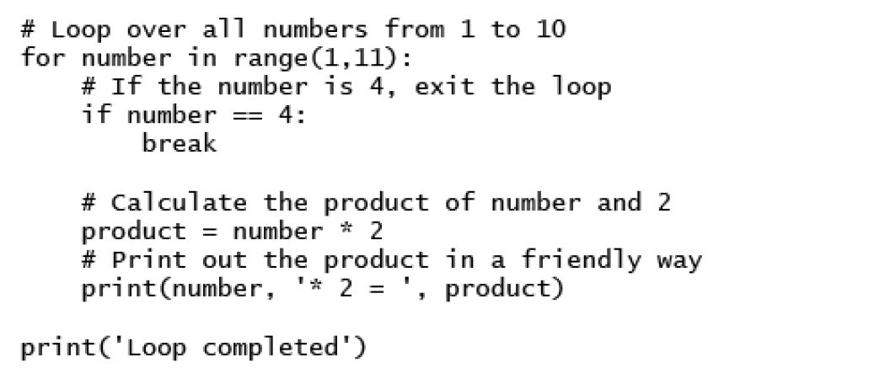
Lesson 3.9.1: The break Statement (2 of 2)
Snippet 3.59

Slide 18
Lesson 3.9.2: The continue Statement (1 of 3)
Allows you to skip over part of loop where external condition is triggered, but goes back to top of loop and continues execution.
Usually used in conjunction with if statement.
Example is shown in Snippet 3.61 with the output shown in Snippet 3.62.

Slide 19
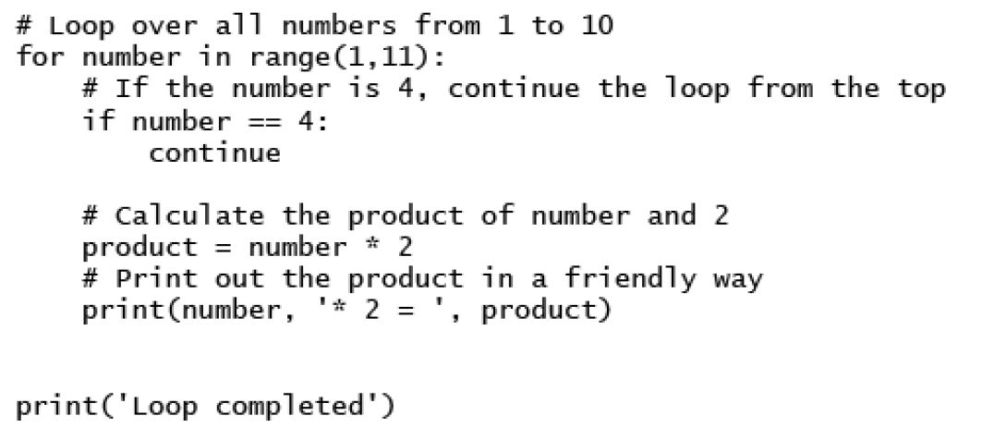
Lesson 3.9.2: The continue Statement (2 of 3)
Snippet 3.61

Slide 20
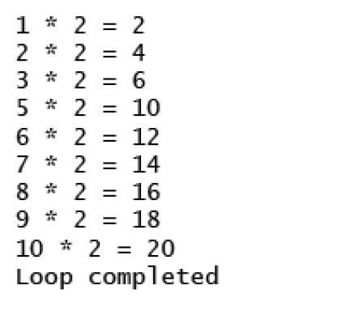
Lesson 3.9.2: The continue Statement (3 of 3)
Snippet 3.62

Slide 21
Lesson 3.9.3: The pass Statement (1 of 2)
Allows you to handle an external trigger condition without affecting the execution of the loop.
Example is shown in Snippet 3.63.

Slide 22
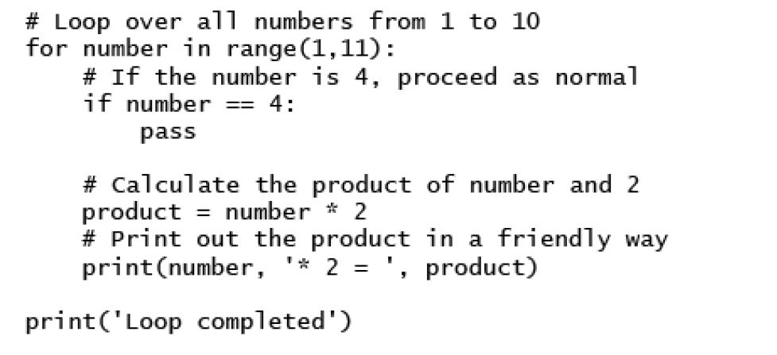
Lesson 3.9.3: The pass Statement (2 of 2)
Snippet 3.63

Slide 23
Summary
In this module:
We have learned about how programs in Python flow.
We also learned how to control and branch the flow of a Python program by using the two main control statements, that is, if and while.
We have also looked at some practical applications of the two control statements and have seen how they differ in implementation and syntax.
We have seen the structure of a for loop.
We have also looked into the range function and how it is useful when you need to quickly iterate over a list.
We have also covered nesting loops and how to break out of loops prematurely under different conditions and with differing results by using the break, continue, and pass statements.

